Slide 1
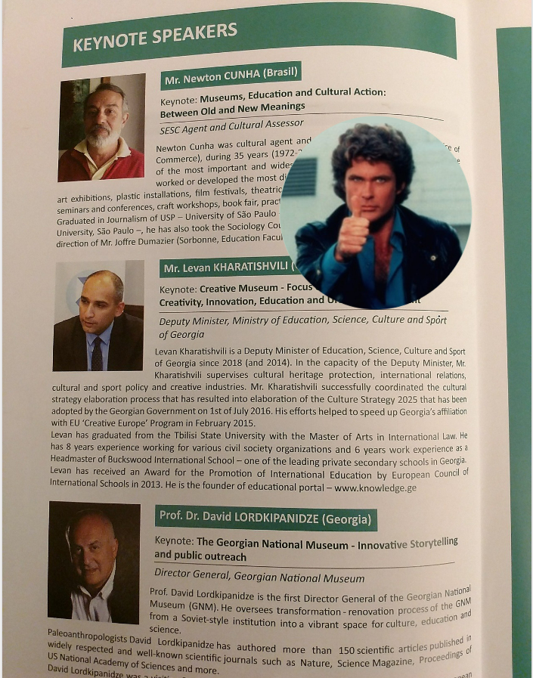
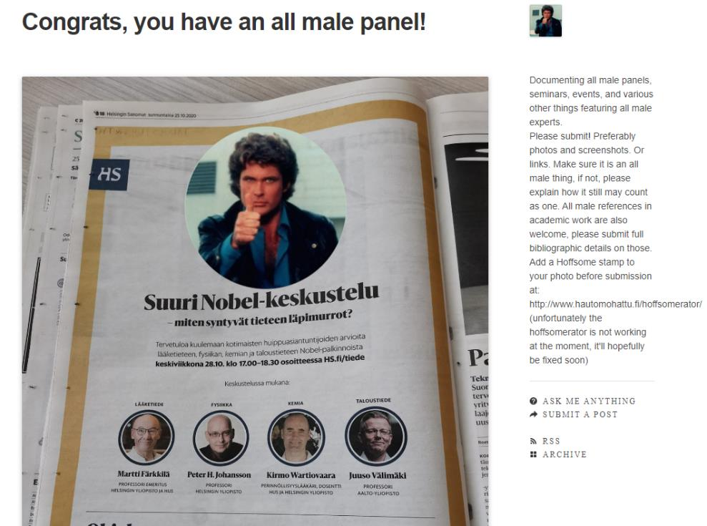
Notes:
25 Min – Making Your Events more Diverse, Equitable and Inclusive
Hi everyone. My name is Sarah Remijan. I’m the director of Learning & Development for Rotary International and I’ve had the honor and stress of planning a few events.
On the screen you’ll see a popular Tumblr page: Congrats, you have an all male panel.
My goal for our time together is to help make sure your event doesn’t end up on this page.
https://blog.swapcard.com/diversity-5-proven-tactics-to-make-your-event-more-inclusive

Slide 2
Questions to ask:
Do the planners / speakers / trainers all share an identity?
What voice is missing from the planning process?
Is your event accessible?
How do participants, organizers, speakers know what behavior is not acceptable?
Do you have procedures to address any concerns raised by participants?
Making Your Events More Diverse, Equitable, and Inclusive
Notes:
I’m here to talk about Making Your Events more Diverse, Equitable and Inclusive.
You should be thinking about this concept during the planning and execution of your event.
Do the planners/speakers/trainers all share an identity? Gender, ethnicity, age. – look at all aspects of your event to avoid tokenism.
What voice is missing from the planning process? Consider your audience and ensure their voice is represented.
Is your event accessible? Consider access for those with disabilities, dietary needs, and cost.
How do participants, organizers, speakers know what behavior is not acceptable? Do you have a code of conduct? How do you communicate this? Do all agree to it?
Do you have procedures to address any concerns raised by participants? This can be from someone complaining about how their name appears on their name badge to someone reporting an incident of discrimination. Consider how you will handle it and who will be responsible.

Slide 3
A few rotary resources
Rotary DEI Code of Conduct asks members to:
  Use respectful language
  Be supportive
  Foster a welcoming and inclusive environment
  Celebrate diversity
Rotary policy 26.120 states that Rotary is committed to maintaining an environment that is free of any form of harassment
Abuse and Harassment Allegation Reporting Guidelines on My Rotary

Slide 4
QUESTIONS/
STRATEGIES TO SHARE

Slide 5
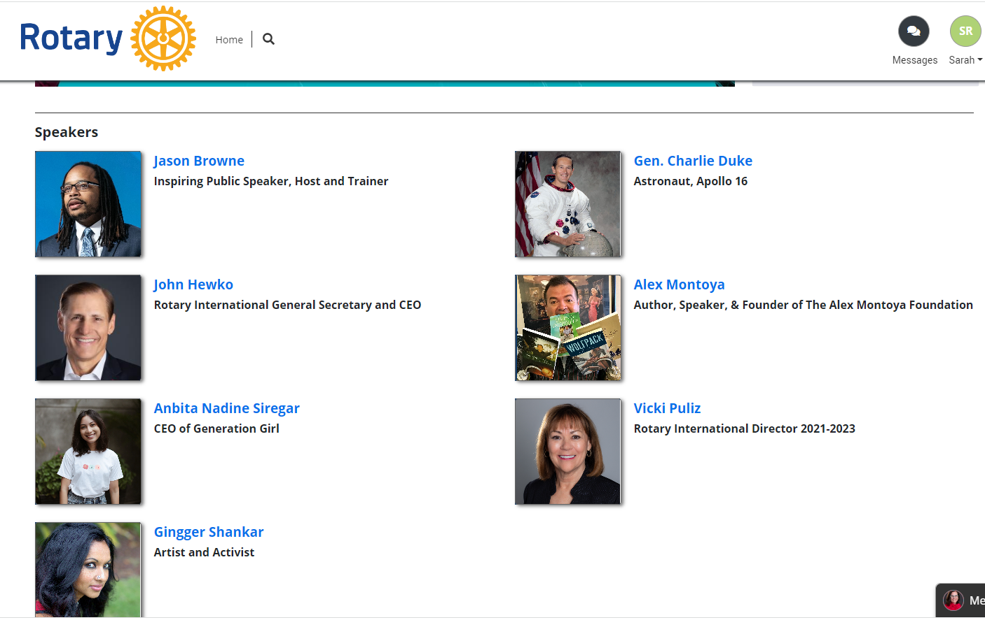
Notes:
And to close out, I share the speakers from general sessions two of the Houston convention which would not qualify for the tumblr: Congrats, you have an all male panel.
Thank you!

Slide 6
